Slide 1

KNOWX
Hybrid RAG Framework for Enterprise Knowledge Management
Review – 2
Methodology | System Design | Implementation | Results | Evaluation

Slide 2
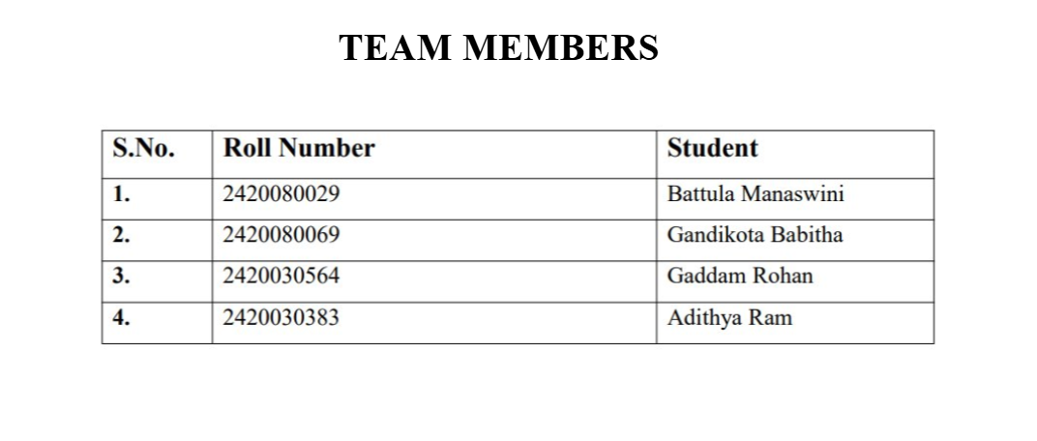

Slide 3
Problem Statement
The problem we are trying to solve
Company information is spread across reports, presentations and different documents.
A keyword search works well when the exact words are present.
But users can ask the same question using different words.
Semantic search helps with meaning, but exact terms and numbers can still be missed.
KNOWX combines both before the answer is generated.
Example
“What are Microsoft's major sources of revenue?”
KNOWX | Review–2

Slide 4
Objectives
What we are building
1.
Prepare enterprise documents and split them into searchable chunks.
2.
Use Sentence Transformers + FAISS for semantic search.
3.
Use BM25 for exact keyword matching.
4.
Combine both rankings using Reciprocal Rank Fusion (RRF).
5.
Rerank the retrieved chunks using a cross-encoder.
6.
Generate a grounded answer using Llama 3 8B.
7.
Evaluate the complete pipeline against simpler approaches.
KNOWX | Review–2

Slide 5
Methodology
The implementation is being done in this order.
Documents
Chunking
FAISS
BM25
RRF
Reranker
Llama
→
→
→
→
→
→
PDF / DOCX / PPTX
searchable text
semantic search
keyword search
combine ranks
select evidence
generate answer
The main idea: retrieve useful evidence first, then ask the LLM to answer from that evidence.
KNOWX | Review–2

Slide 6
System Design
Query flow
Semantic Search
User
Question
→
→
RRF
→
Reranker
→
Llama 3 8B
BM25 Search
Metadata is kept with every chunk: company, document name and chunk number.
This is what we will use for source traceability in the final answer.
KNOWX | Review–2

Slide 7
Modern Tools and Technologies
Python 3.11
GPU-side development
Sentence Transformers
semantic embeddings
FAISS
vector similarity search
BM25
keyword search
RRF
rank fusion
Cross-Encoder
reranking
Llama 3 8B
answer generation
NVIDIA A100 80GB
GPU inference
KNOWX | Review–2

Slide 8
Implementation
Current project execution
9 documents processed from Microsoft, NVIDIA and Infosys.
5,000,829 characters extracted.
6,256 chunks created.
FAISS: 6,256 vectors with 384 dimensions.
BM25 index: 6,256 chunks.
10 semantic + 10 BM25 candidates are used for hybrid retrieval.
Cross-encoder returns the final top 5.
9
documents
6,256
chunks
384
dimensions
5
final chunks
KNOWX | Review–2

Slide 9
Results So Far
Test query: “What are Microsoft's major sources of revenue?”
Retrieval output
Semantic
BM25
RRF
Reranker
10
10
19 unique
5
Top reranked chunks
Rank
Company
Chunk
Score
1
Microsoft
264
1.9001
2
Microsoft
342
1.6605
3
Microsoft
123
0.6038
4
Microsoft
201
-1.1507
5
Microsoft
140
-1.8751
These are reranker scores, not accuracy percentages.
KNOWX | Review–2

Slide 10
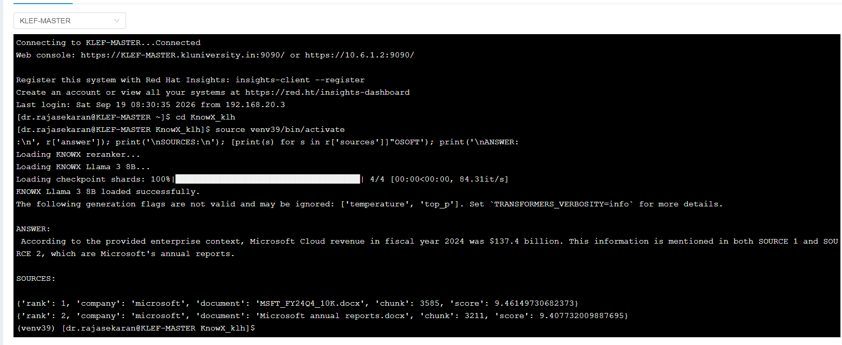

Slide 11
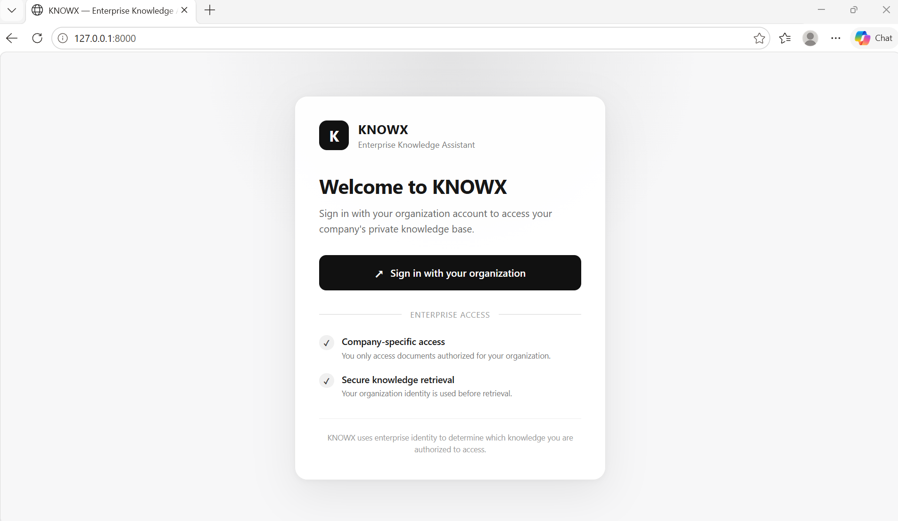

Slide 12
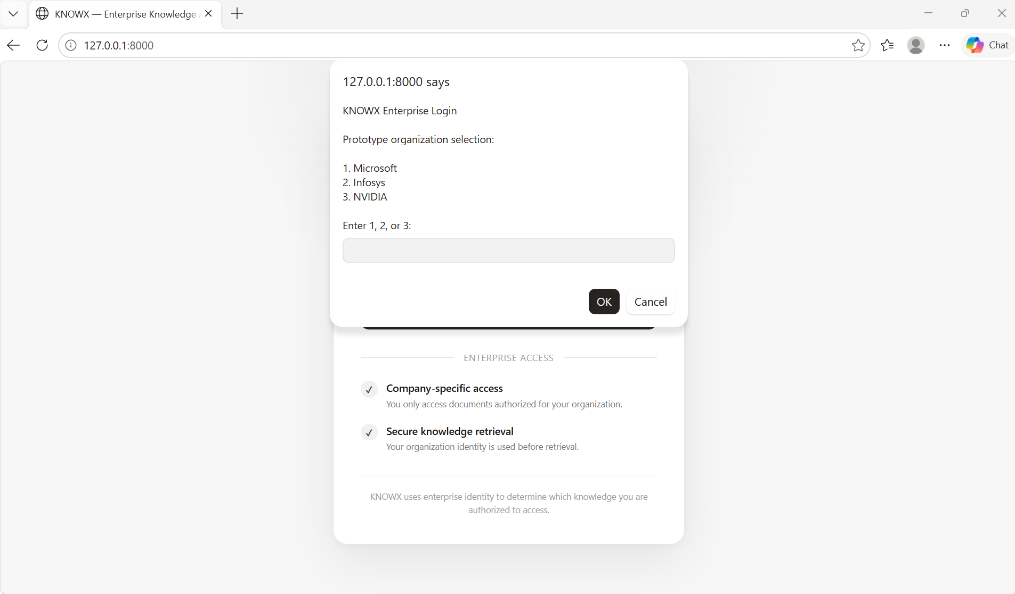

Slide 13
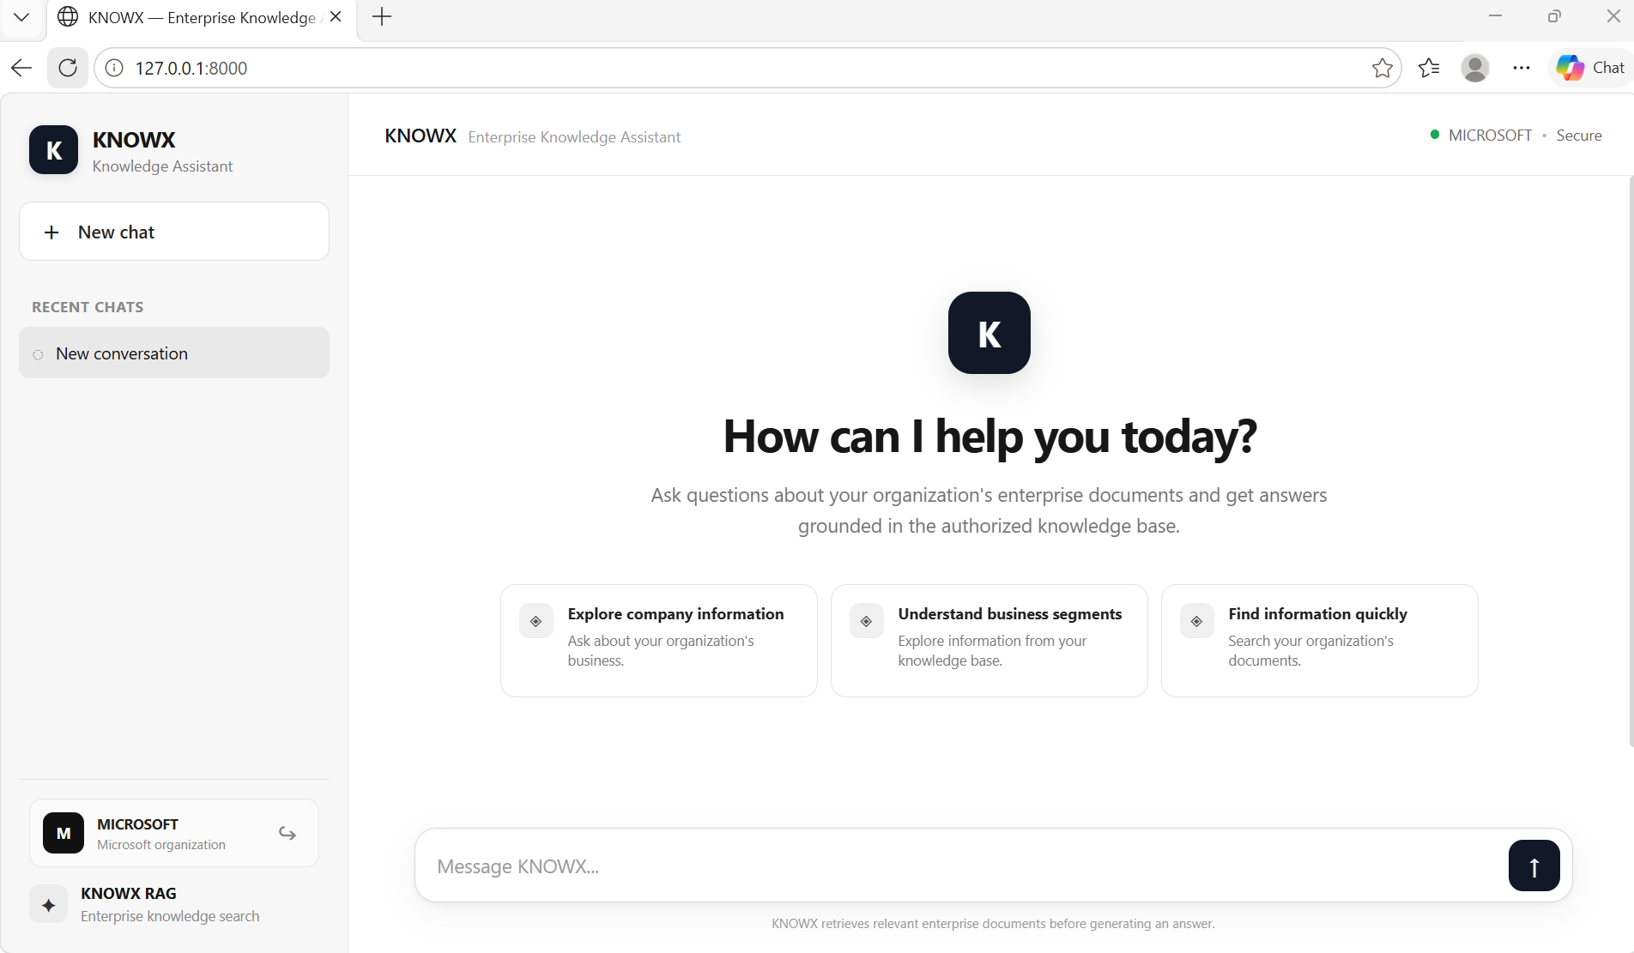

Slide 14
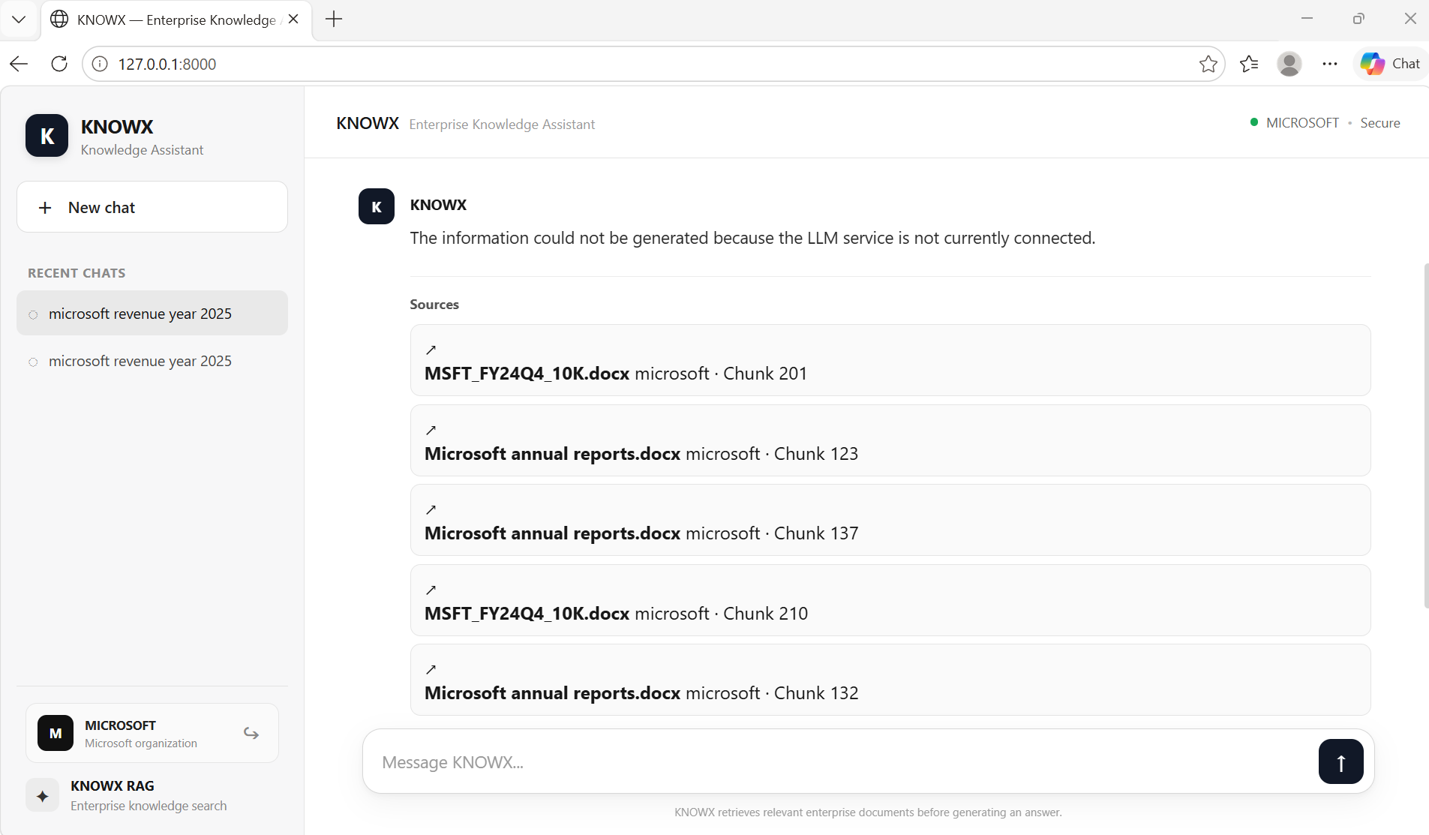

Slide 15
Performance Evaluation
Already measured
To be measured
Number of indexed documents/chunks
Semantic candidate count
BM25 candidate count
RRF candidate count
Final reranked chunks
Recall@k and MRR
Semantic-only vs BM25 vs hybrid
Effect of reranking
Answer relevance / faithfulness
End-to-end latency on A100
We will report an accuracy/quality number only after running the labelled evaluation set.
KNOWX | Review–2

Slide 16
Innovation and Novelty
What is different in our approach
Hybrid search
Uses semantic meaning and exact keyword matching together.
RRF
Combines the rankings without depending on their raw score scales.
Reranking
Checks the strongest candidates again before generation.
Traceability
Company, document and chunk information stays attached.
Practicality
Each stage can be tested separately instead of using one large black box.
KNOWX | Review–2

Slide 17
Project Execution – Review 2
Completed
Next steps
Ingestion
Chunking
FAISS index
BM25 index
Hybrid retrieval
Reranking
Run Llama 3 8B on A100
Add source citations
Prepare evaluation questions
Complete Frontend Integration
Complete paper
Evaluation results of model
The retrieval side is working. The next major step is connecting the GPU generation stage.
KNOWX | Review–2

Slide 18
Key References
Lewis et al. (2020) – Retrieval-Augmented Generation for Knowledge-Intensive NLP Tasks
Karpukhin et al. (2020) – Dense Passage Retrieval for Open-Domain Question Answering
Guu et al. (2020) – REALM
Asai et al. (2023) – Self-RAG
Gao et al. (2023) – HyDE
Yan et al. (2024) – Corrective RAG
Edge et al. (2024) – GraphRAG
Sarthi et al. (2024) – RAPTOR
Yu et al. (2025) – EKRAG
Lee et al. (2025) – HybGRAG
Tua & Fitrianah (2026) – enterprise hybrid retrieval / reranking
KNOWX | Review–2

Slide 19
THANK YOU

